Slide 1



COMP9900 Computer Science / Information Technology Project Project Demo
Project 5: Assistant for preparation for radiology examination
Tingfeng Lin z5147976(Scrum Master)
Yi Xiao z5125251
Yousheng Sui z5156244
Yan Duan z5145036

Slide 2
Project structure

Slide 3
Project environment
Project divided into 3 parts
Backend including API
Frontend
Chatbot
Using HTTP to communicate.
Deployed on different IP and port like microservices
Remote server: CentOS7.0 (deploy at Alibaba cloud)
Database: MySQL8 (deploy in docker at remote server)
File server: Apache file server (deploy at remote server)
Development tools: Pycharm, WebStorm, Navicat, Hbuilder
Browser: support IE8+

Slide 4

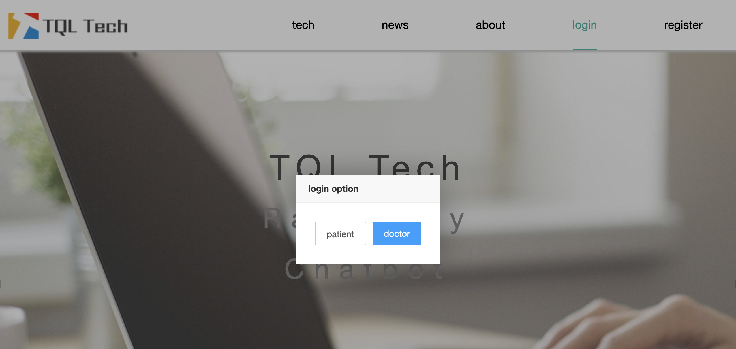
User login
Choose the role of the user
Type valid username and password

Slide 5
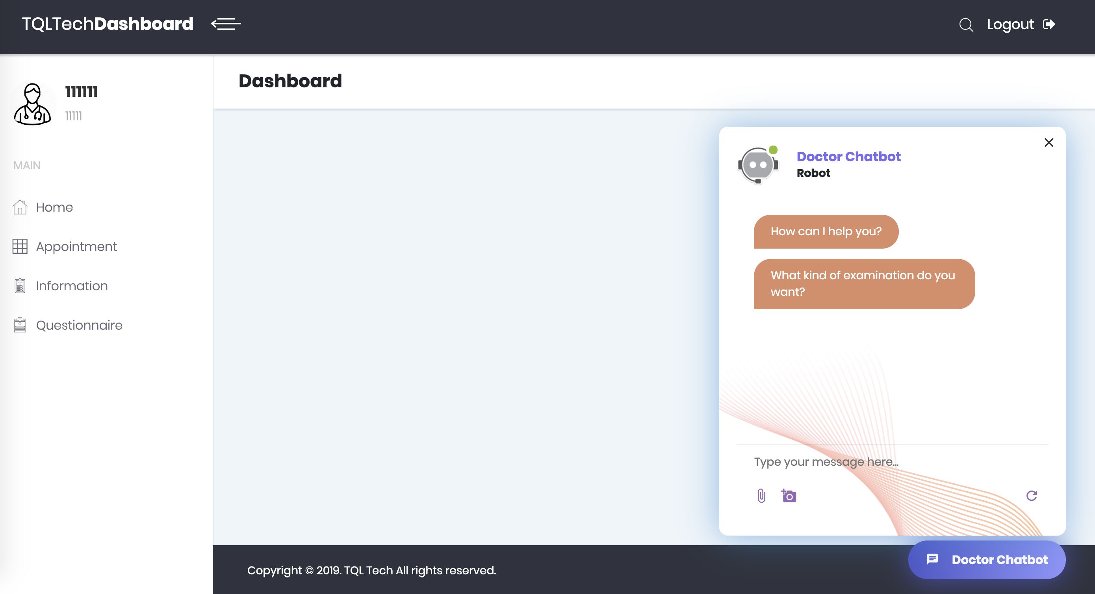
Booking appointment
Type question in the input area
Follow the instruction to finish the booking

Slide 6
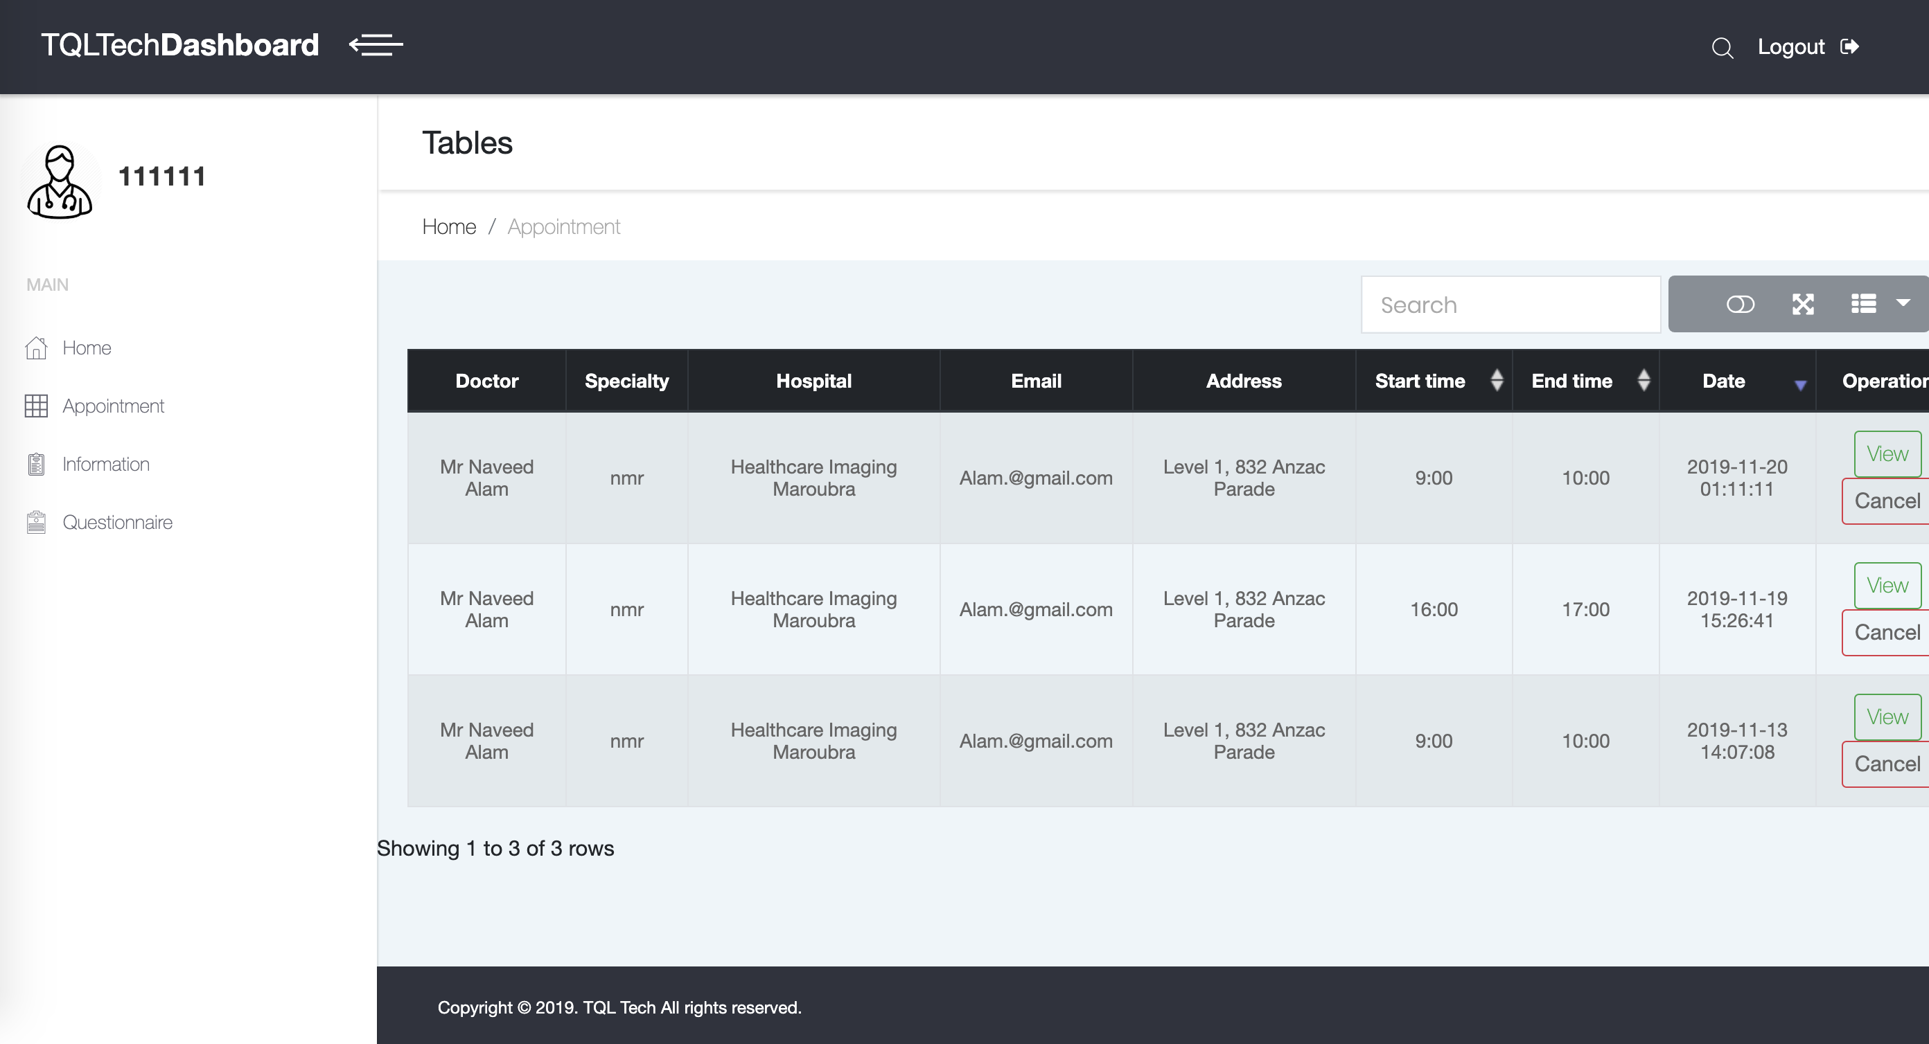
Appointment checking
Checking the appointment
View specific location
Cancel appointment

Slide 7
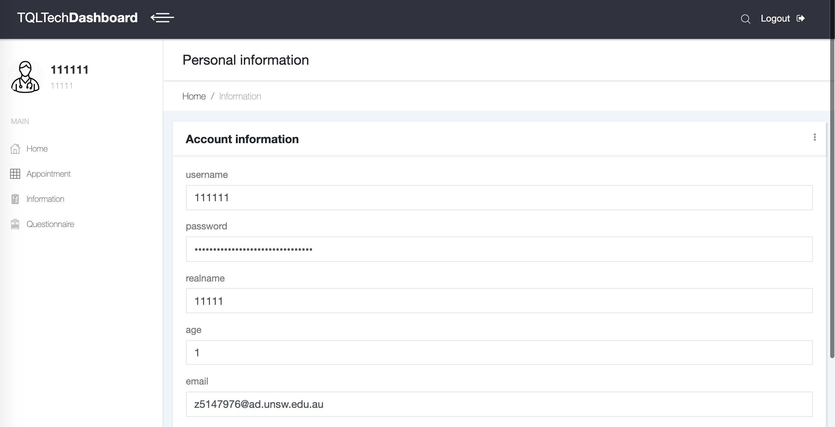
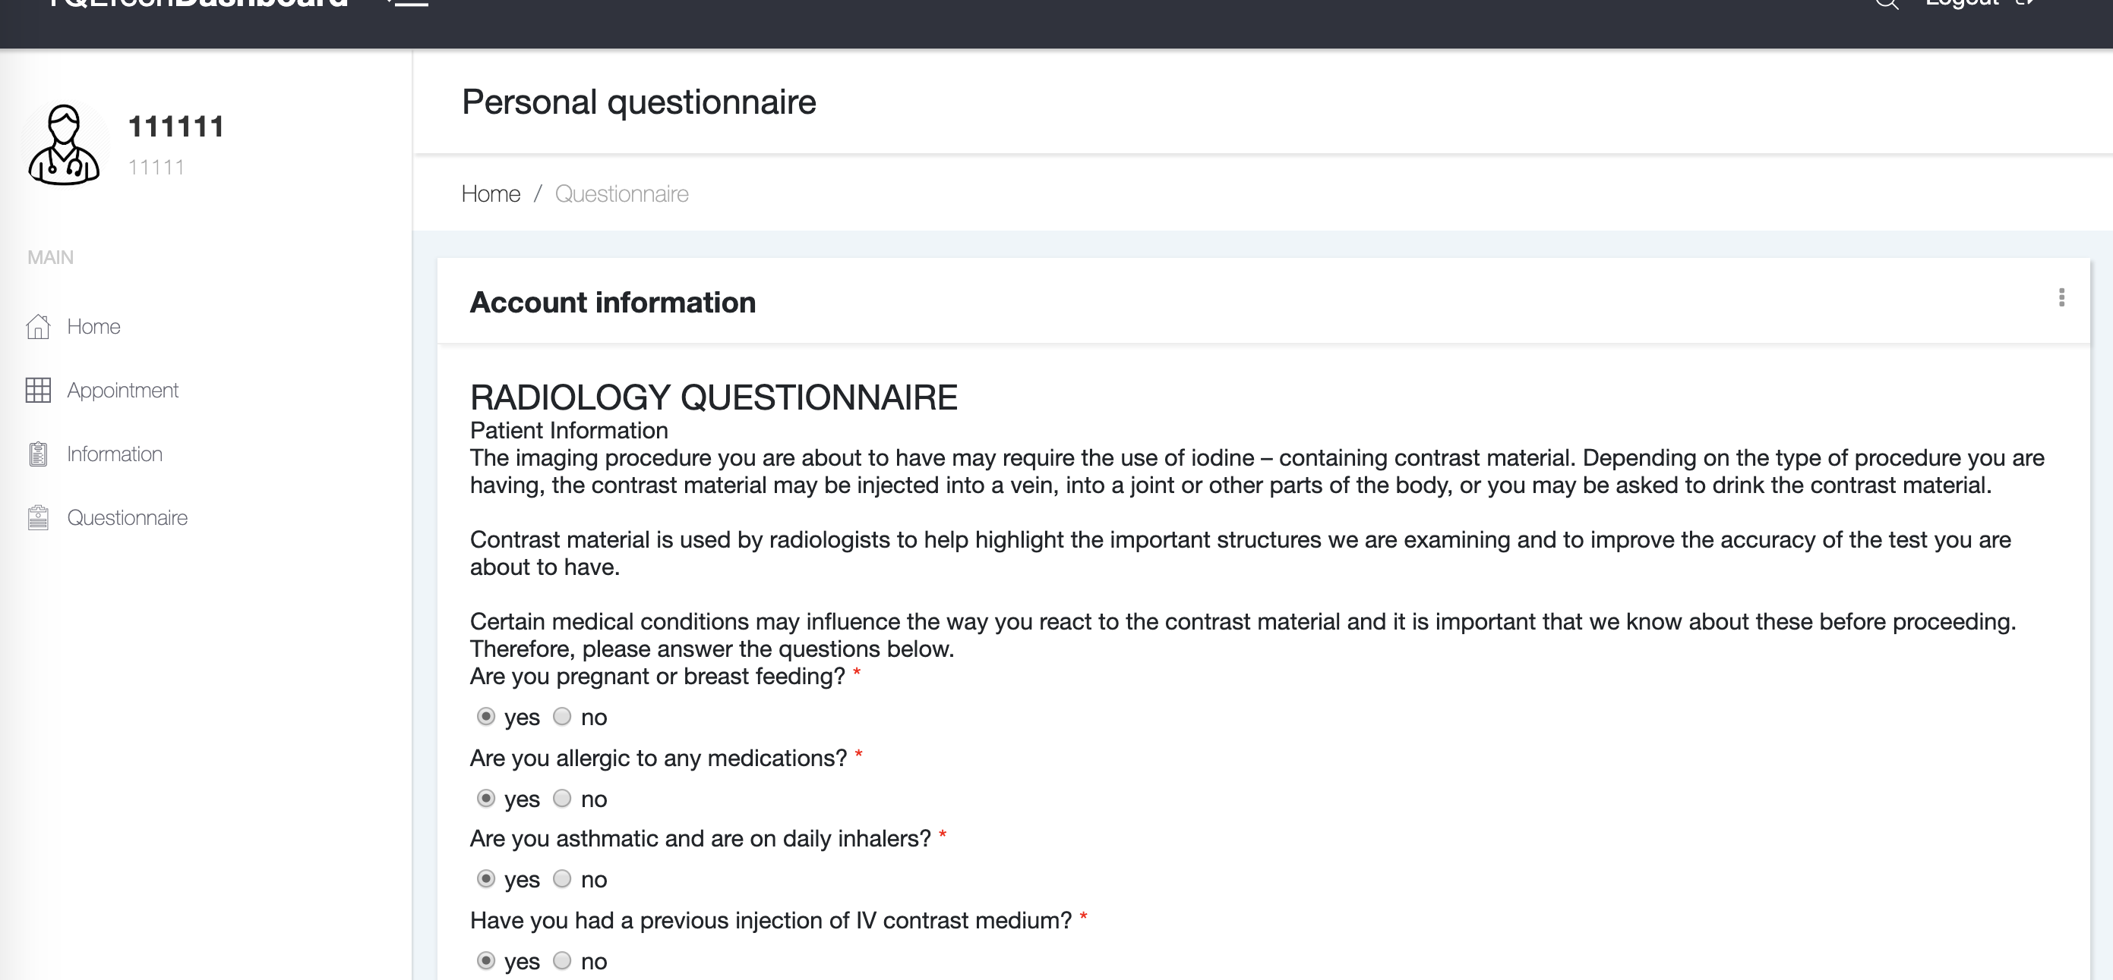
Update personal information & update questionnaire

Slide 8
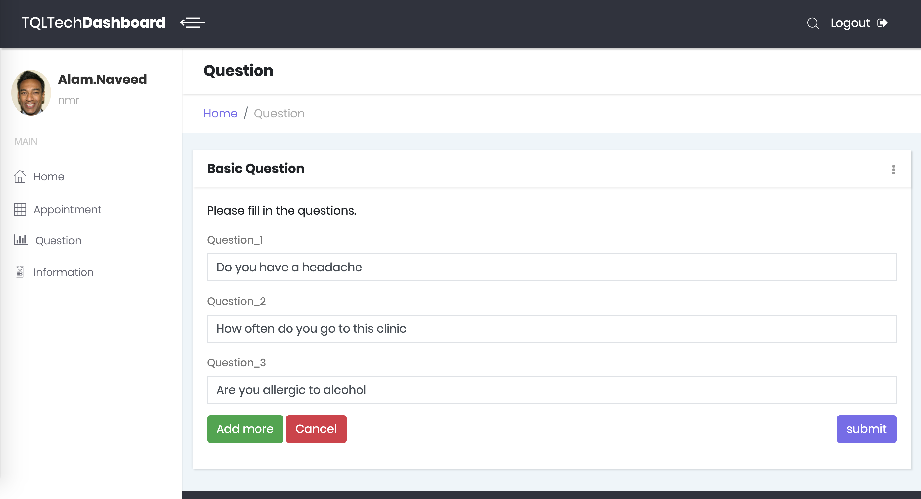
Doctor question setting
Add questions(max 5)
Delete questions

Slide 9
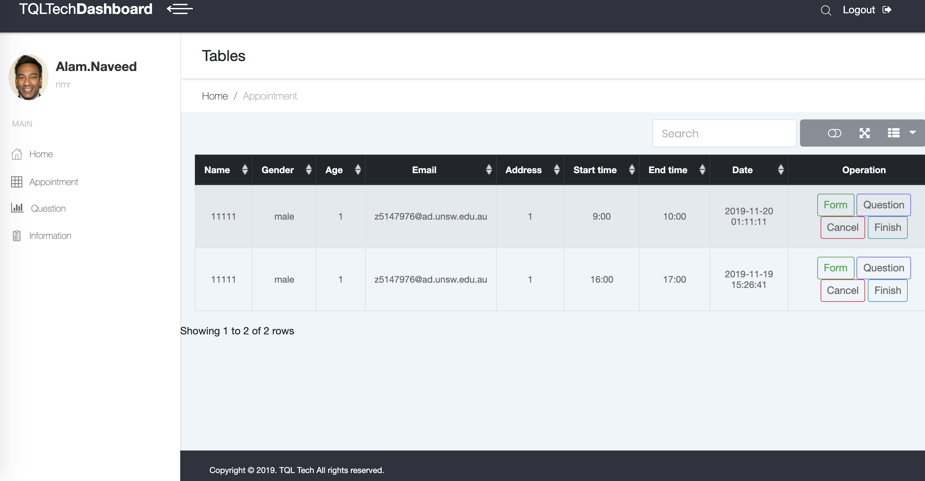
Doctor checking appointment
Check user questionnaire
Check user answer
Cancel appointment
Finalize appointment

Slide 10
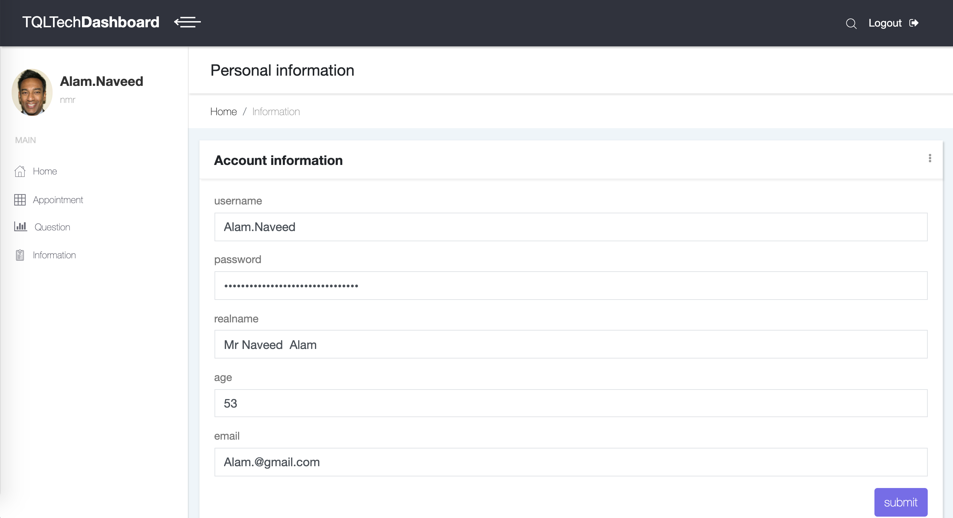
Doctor update information

Slide 11
Two ChatBot Modules:
Task Oriented chatbot: analyze rough meaning of input sentences.
General dialogue chatbot: response for General conversation.

Slide 12
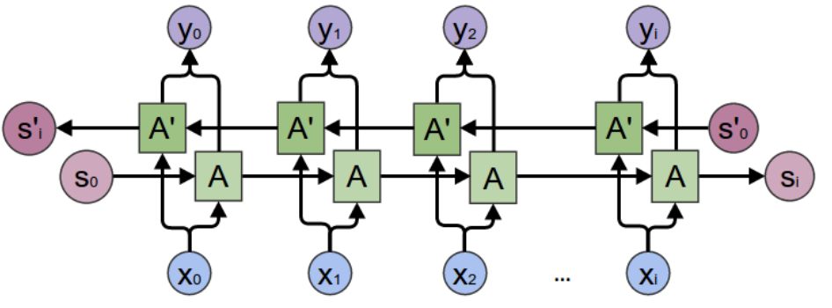
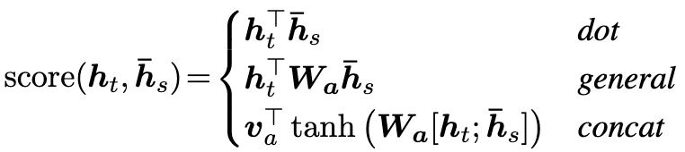
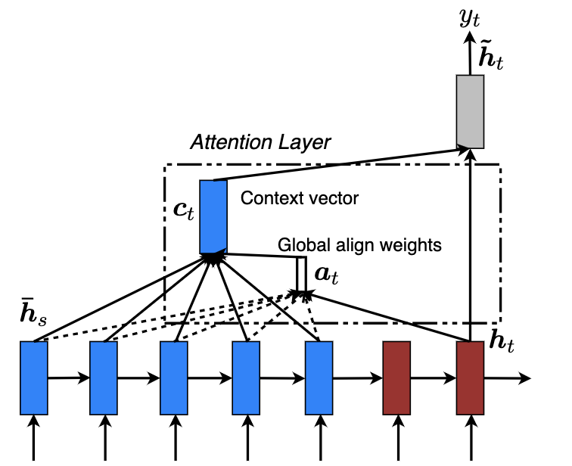
General dialogue Chatbot Encoder:
Decoder:
Compared with Encoder, GRU is unidirectional
in decoder. The softmaxed result comes from
Attention score and unidirectional GRU outputs.
Bidirectional GRU
Gobal attention:
We chose dot product to calculate attention
score.

Slide 13
Thanks for listening!

